Slide 1
E-COMMERCE SALES & CUSTOMER
ANALYTICS SYSTEM
Final Business Analytics Presentation
Prepared By: Srijan Poudel
Data Analytics Intern • SATRI
Excel • PostgreSQL • Python/Pandas • Power BI
1

Slide 2
Business Problem
What management needs to understand
• What is driving sales and profit?
• Which products and categories perform well or poorly?
• Which customers provide greater value?
• How do regions differ in sales and profitability?
• How are discounts related to sales and profit?
2

Slide 3
Objectives & Analytics Workflow
OBJECTIVES
Sales • Profit • Customers
Products, regions, trends, discounts and business recommendations.
Excel
PostgreSQL
Python
Power BI
OUTPUT
Interactive Power BI Dashboard
Evidence-based insights and management recommendations.
Understand & clean
Business SQL analysis
EDA & statistics
Dashboard & reporting
3

Slide 4
Dataset & Data Quality
Records
9,994
Customers
793
Products
1,862
Categories
3
Regions
4
• Coverage: January 2014 – December 2017
• 21 columns covering orders, customers, products, sales, discounts, profit and regions
• No missing values and no duplicate full rows
• Dates and numeric fields validated; invalid basic records were not identified
• Potential IQR outliers were documented rather than automatically removed
4

Slide 5
Overall Business Performance
Key KPIs from the analyzed dataset
Total Sales
$2.30M
Total Profit
$286.40K
Orders
5,009
Customers
793
Average Order Value
$458.61
Profit Margin
12.47%
5

Slide 6
Sales & Category Analysis
SALES TREND
$484K → $733K
Annual sales increased from 2014 to 2017.
TOP CATEGORY
Technology
Highest category sales and profit.
WATCH
Furniture • 2.49%
Substantial sales but much lower profit margin.
• 2014 sales: approximately $484,248
• 2017 sales: approximately $733,215
• Technology sales: approximately $836,154
• Furniture sales: approximately $742,000, but only 2.49% profit margin
6

Slide 7
Product Analysis
Sales volume does not always equal profitability
TOP PRODUCT
Canon imageCLASS 2200 Advanced Copier
Highest-selling product and also highly profitable.
SALES ≠ PROFIT
Cisco TelePresence EX90
~$22.6K sales but ~-$1.81K profit.
• Cubify CubeX Double Head Print: ~-$8.88K profit
• Lexmark MX611dhe Monochrome Laser Printer: ~-$4.59K
• Cubify CubeX Triple Head Print: ~-$3.84K
• Product-level profitability should be monitored alongside sales
7

Slide 8
Customer Analysis
Understanding customer value beyond sales
Unique Customers
793
Repeat Customers
781
One-time Customers
12
Repeat Rate
98.49%
• Average customer spend: approximately $2,896.85
• High customer sales value does not necessarily imply high profitability
• Sean Miller had approximately $25,043 sales but recorded approximately $1,981 loss
• Customer evaluation should consider both sales and profit
8

Slide 9
Regional & Discount Analysis
WEST
$725K Sales • $108K Profit
Highest sales and profit among the four regions.
CENTRAL
7.92% Margin
Lowest regional profit margin.
HIGH DISCOUNTS
Negative Profit
Several high-discount groups recorded negative aggregate profit.
• West margin: 14.94% • East: 13.48% • South: 11.93% • Central: 7.92%
• 70% discount group: approximately -$40,075 profit
• 80% discount group: approximately -$30,539 profit
• Discount and profit show a negative relationship in the historical dataset
9

Slide 10
Statistical & Correlation Analysis
Sales Median
$54.49
Profit Median
$8.67
Sales ↔ Profit
0.48
Discount ↔ Profit
-0.22
• Sales and profit distributions are right-skewed because means are substantially higher than medians.
• Sales and profit show a positive correlation.
• Quantity and sales show a weak positive relationship.
• Discount and profit show a negative relationship.
• Correlation indicates association, not causation.
10

Slide 11
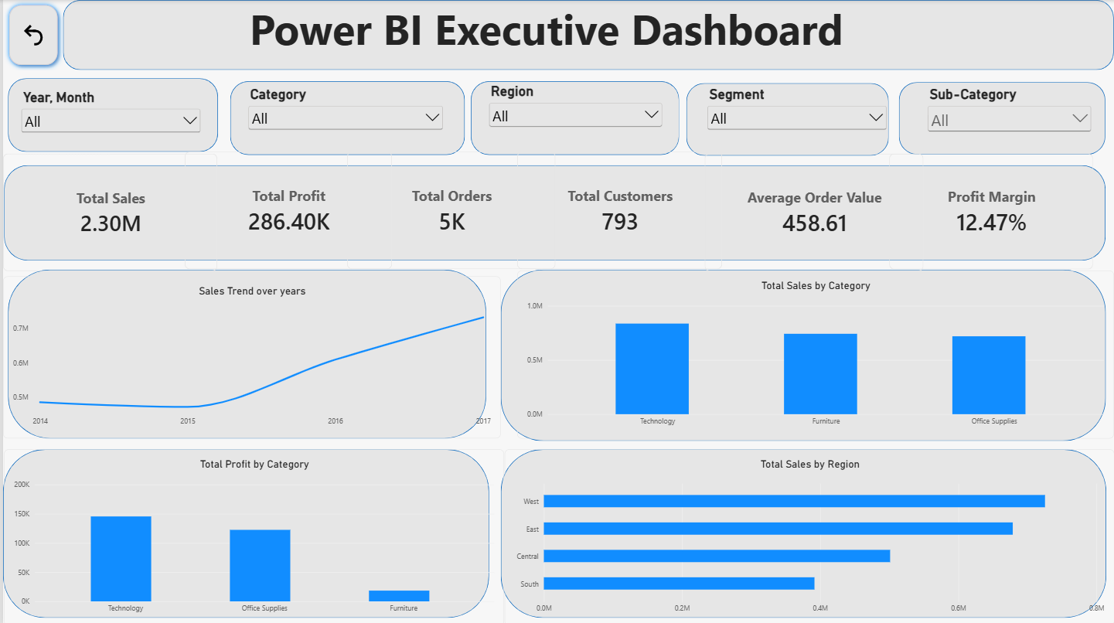

Slide 12
Key Findings & Recommendations
KEY FINDINGS
• Technology leads category sales and profit.
• Furniture has a low 2.49% profit margin.
• West leads regional sales and profit.
• Several products and high-sales customers are loss-making.
• High discount levels are associated with weaker profitability.
RECOMMENDATIONS
• Review products with repeated negative profit.
• Monitor high-discount transactions with management thresholds.
• Evaluate low-margin Furniture products and sub-categories.
• Use both sales and profit when prioritizing customers/products.
• Track regional sales and profit regularly through Power BI.
12

Slide 13
Conclusion
Sales volume alone does not fully describe business performance.
Profitability varies by category, region, product, customer and discount level.
The Power BI dashboard provides an interactive way to monitor these areas and support data-driven management decisions.
Thank You • Questions?
13

